Slide 1
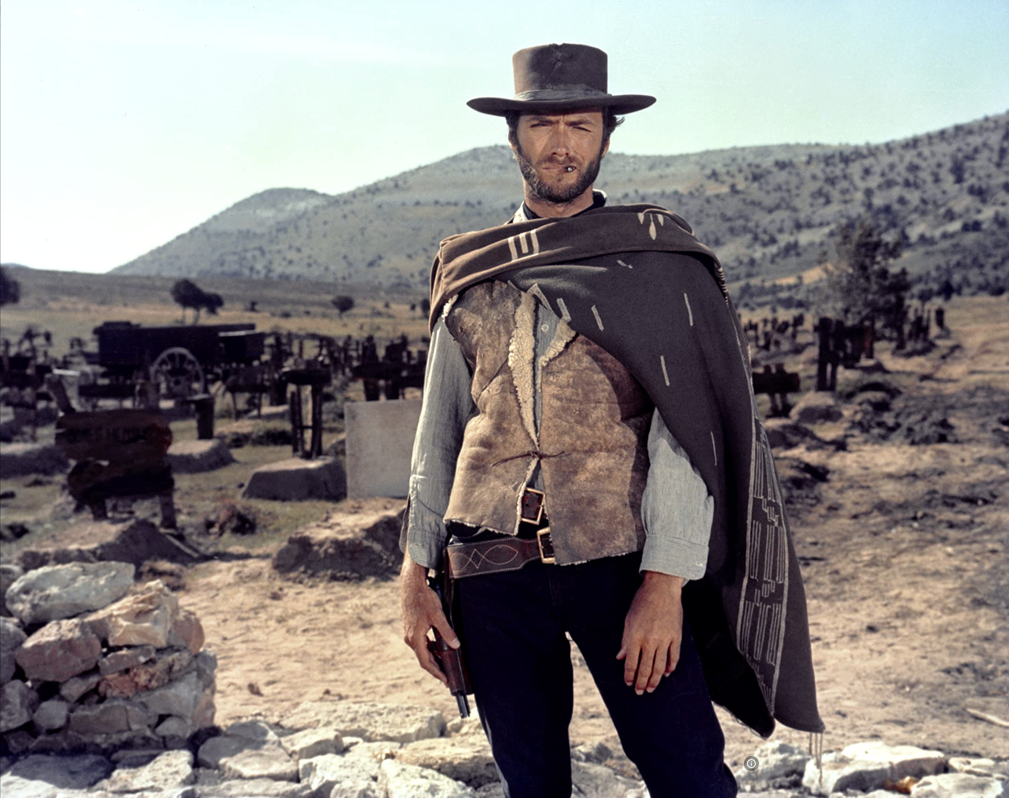

The Easy, the Hard and the Ugly
Easy
Inference (fit)
Fine-Tuning (predict)
Hard
Pre-training
Ugly (Responsible AI)
Bias
Toxicity
Misinformation
Hallucinations
Plagiarism

Slide 2
Ugly: Outline
Benchmarking (Ken)
Labeling (Omar)
Bias, toxicity, misinformation, plagiarism (Ken)
1 slide on hard problems for researchers/practitioners

Slide 3
Benchmarking

Slide 4

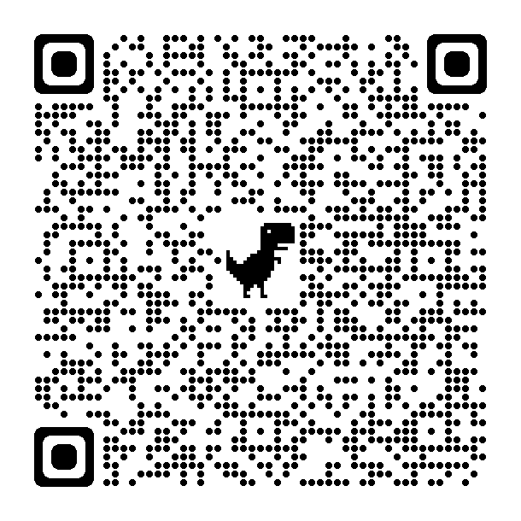
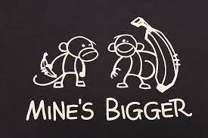
Benchmarking: Big Fan of Metrics (EMNLP)
Clichés
Lack of Substance
Whatever you measure, you get
Be careful what you ask for
It’s difficult to make predictions, especially about the future
Yogi Berra
SOTA-Chasing
Pointless Mindless Metrics
(The point should be to make progress on a real problem)
Experimental Psychology
Validity
Reliability

Slide 5
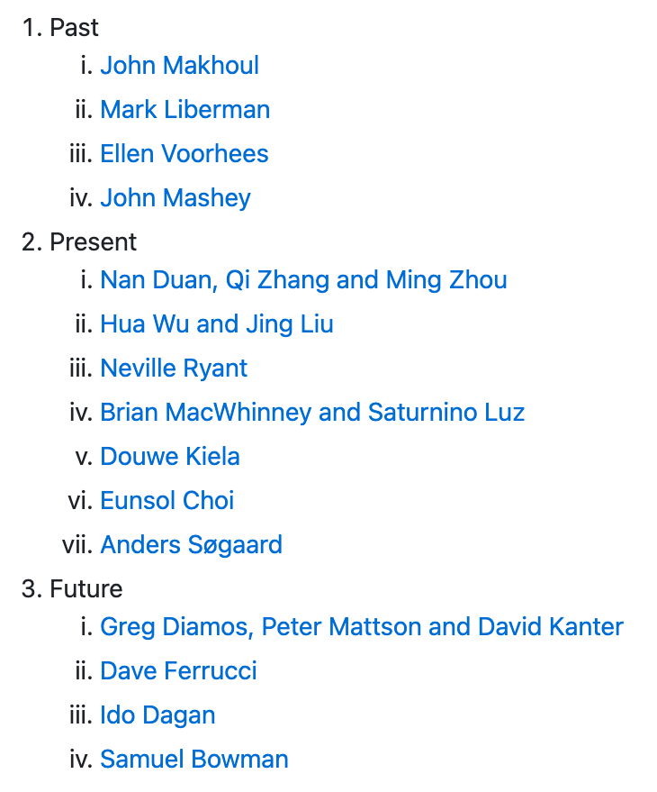
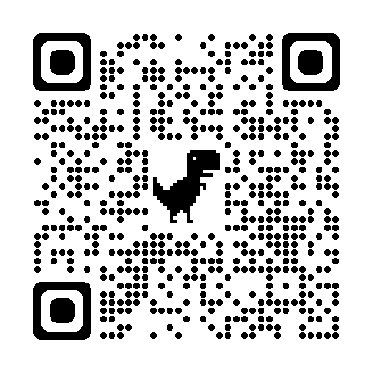
Benchmarking: Extrapolation: Past → Future
ACL-2021 Workshop
Benchmarking:
Past, Present and Future
https://github.com/kwchurch/Benchmarking_past_present_future

Slide 6
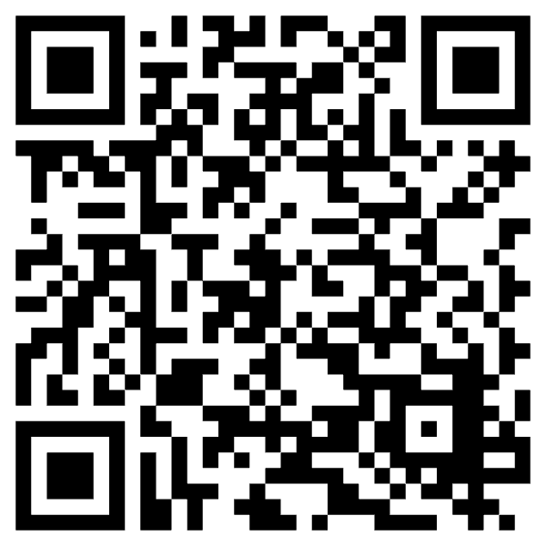
Better Together: Text + Context
https://www.semanticscholar.org/api-gallery/better-together

Slide 7
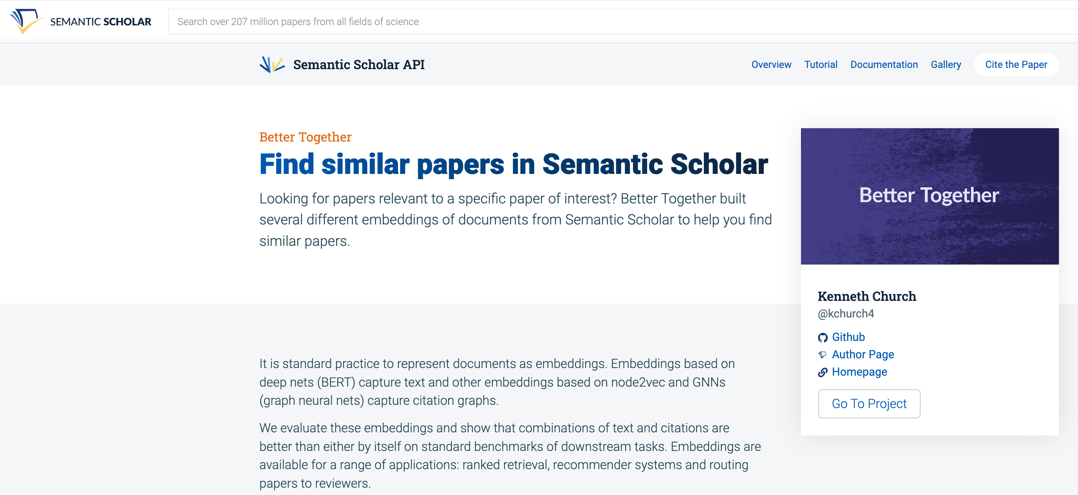
https://www.semanticscholar.org/product/api/gallery
click here

Slide 8

<return>

Slide 9

Better Together: Text (Titles, Abstracts, Body); Context (Citations)
BERT-like Deep Nets
ProNE:
Spectral Clustering

Slide 10
Opportunity: More Realistic Benchmarks
The Real World
Idealizations (Standard Benchmarks)
Large (Metcalfe’s Law)
Growing
Dirty
Missing Values
Bad/misleading Values
Small
Static
Clean

Slide 11
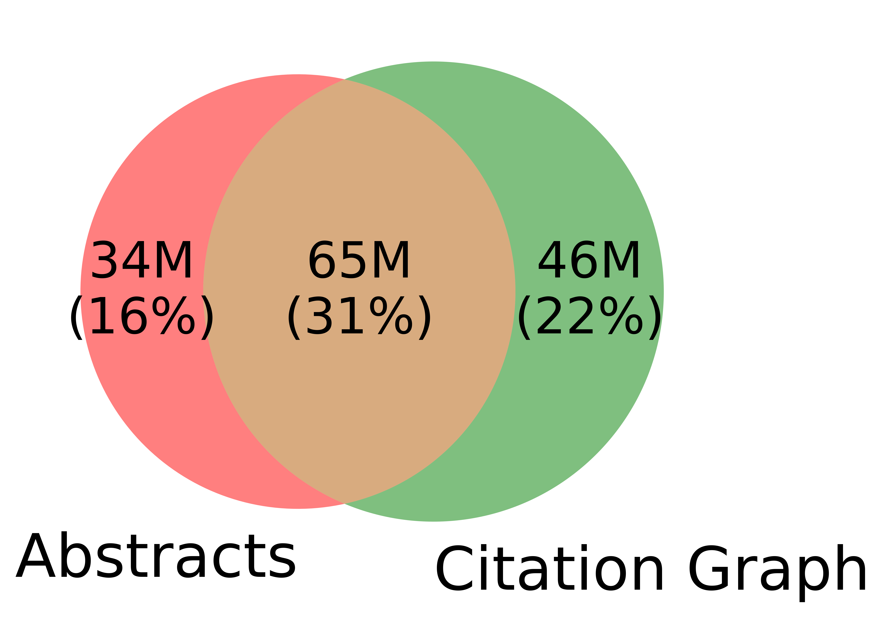
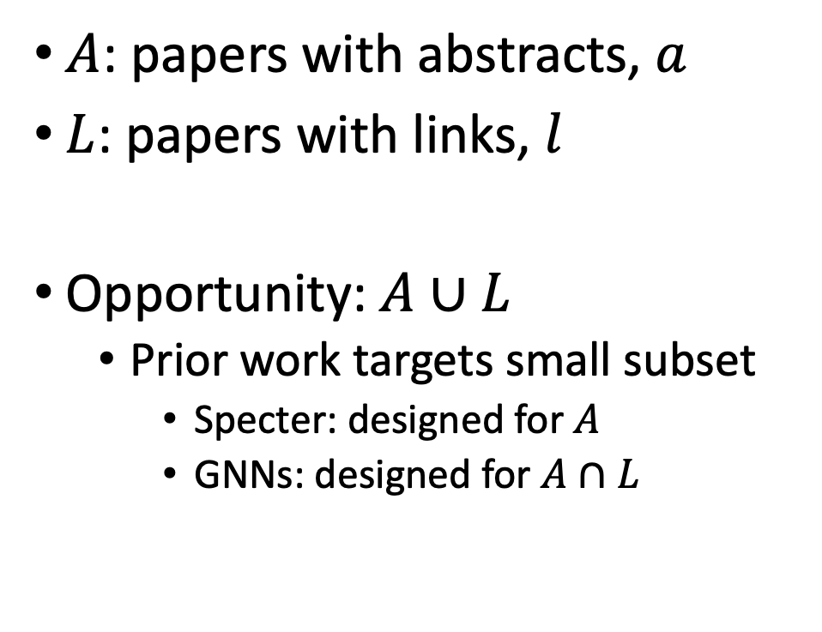
Realities (Dirty): Missing Values
$A$: papers with abstracts, $a$
$L$: papers with links, $l$
Opportunity:$A∪L$
Prior work targets small subset
Specter: designed for $A$
GNNs: designed for $A∩L$
Other
31%

Slide 12


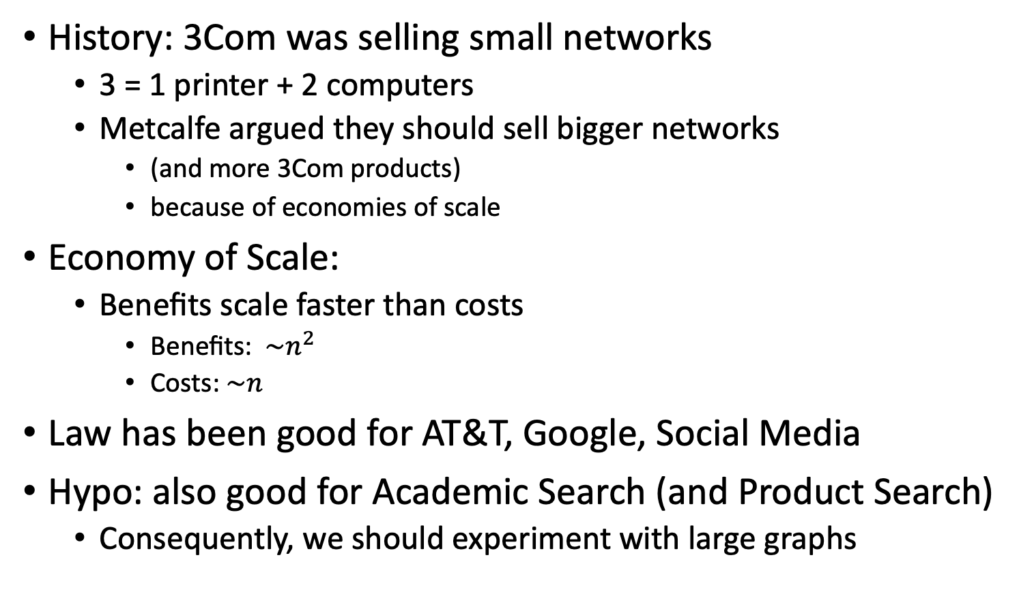
Metcalfe’s Law (Network Effects)
History: 3Com was selling small networks
3 = 1 printer + 2 computers
Metcalfe argued they should sell bigger networks
(and more 3Com products)
because of economies of scale
Economy of Scale:
Benefits scale faster than costs
Benefits: $\sim n^{2}$
Costs:$\sim n$
Law has been good for AT&T, Google, Social Media
Hypo: also good for Academic Search (and Product Search)
Consequently, we should experiment with large graphs

Slide 13
Better-Together Conjectures
Multiple representations are helpful
for missing values (and bad values)
If abstracts are missing, use links
If links are missing, use abstracts
and for graphs of different sizes
When graphs are small:
Text >> Links
when graphs are large:
Links >> Text (Metcalfe’s Law)

Slide 14
Opportunities
Scale
Prediction
Many benchmarks return a single number (figure of merit)
How does performance scale
with the size of the problem?
Standard test/train splits
More relevant to interpolation
than extrapolation
Time is asymmetric
It is difficult to make predictions
especially about the future
-- Yogi Berra

Slide 15
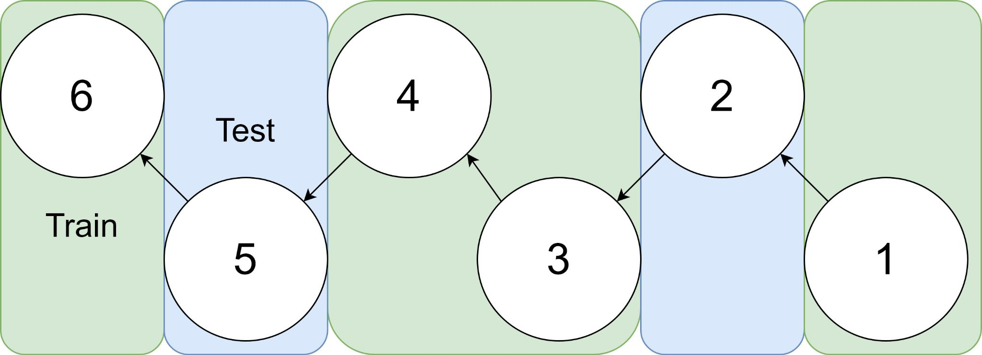
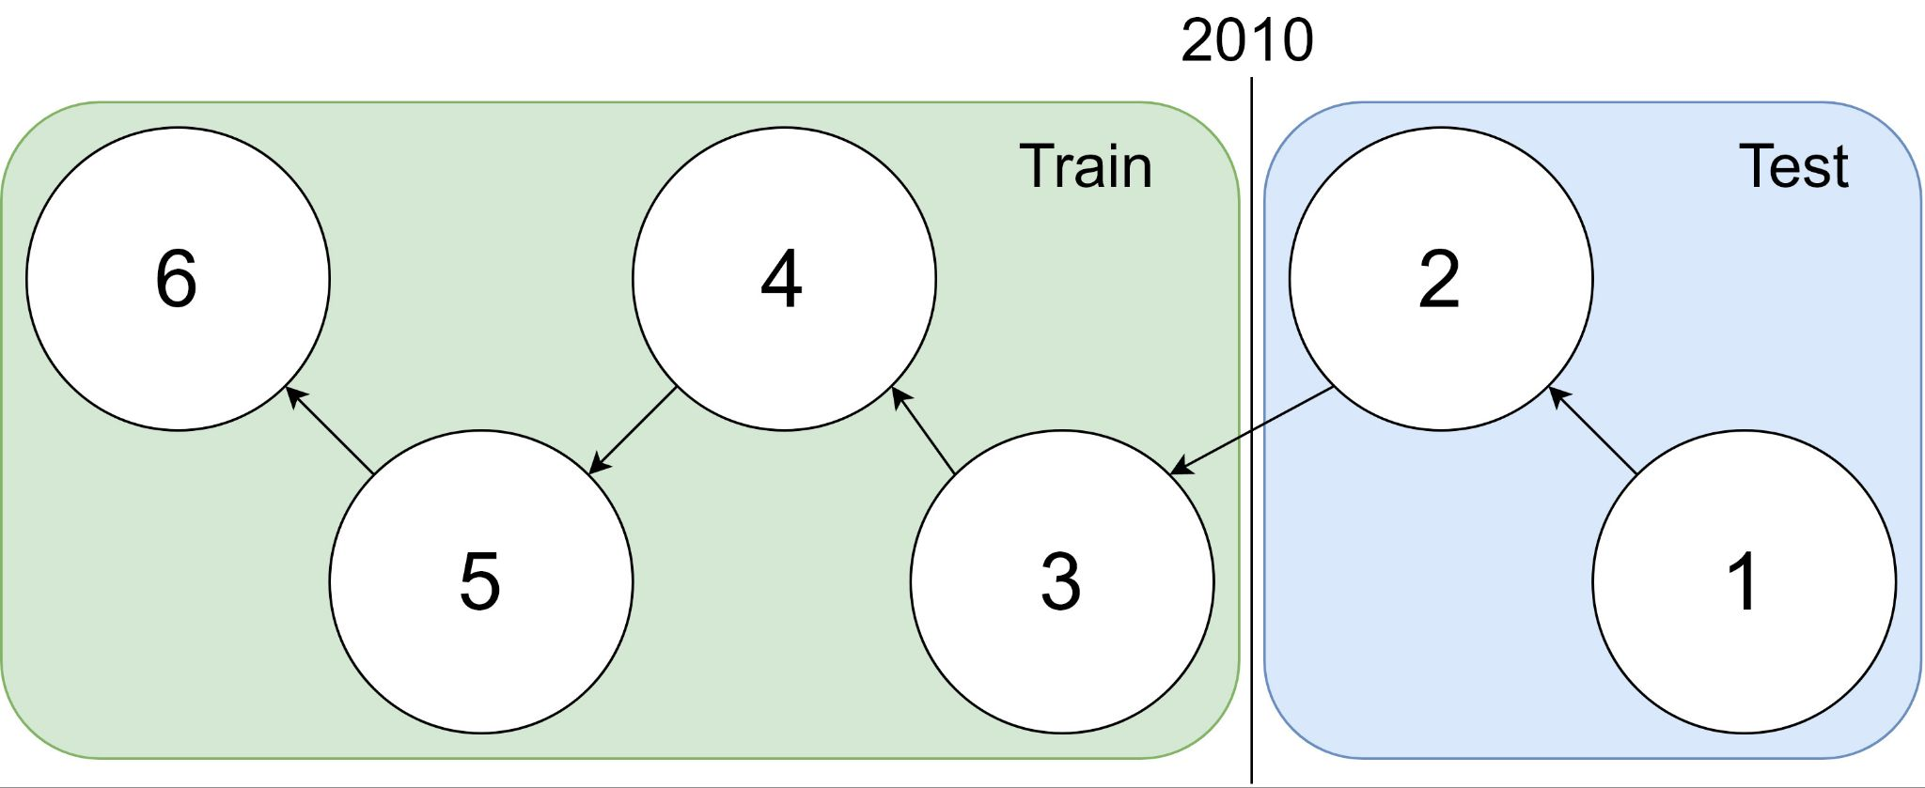
Example: 1 cites 2, 2 cites 3, … 5 cites 6
Traditional Train-Test Split (Non-Causal)
idx | Pub Year | Paper Title
1 | 2018 | [...] Photofragment imaging
2 | 2016 | Convenient probe of S(1D2)[...]
3 | 2005 | Megapixel ion imaging [...]
4 | 2003 | Direct current slice imaging [...]
5 | 1995 | profiles of Cl(2Pj) photofragments [...]
6 | 1988 | Adiabatic dissociation of [...]
Proposed Train-Test Splits (Causal)
Notes:
No asymmetry of time - how to reduce to a soundbite
Audience soundbites
‘Almost all studies in ml do test-train split’ that’s a bad idea when you have time

Slide 16
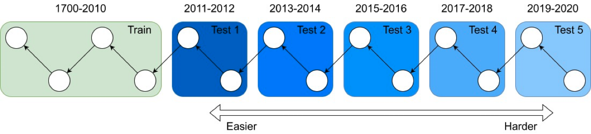
It's tough to make predictions, especially about the future ― Yogi Berra
Forecasting: short-term predictions are easier than long-term

Slide 17
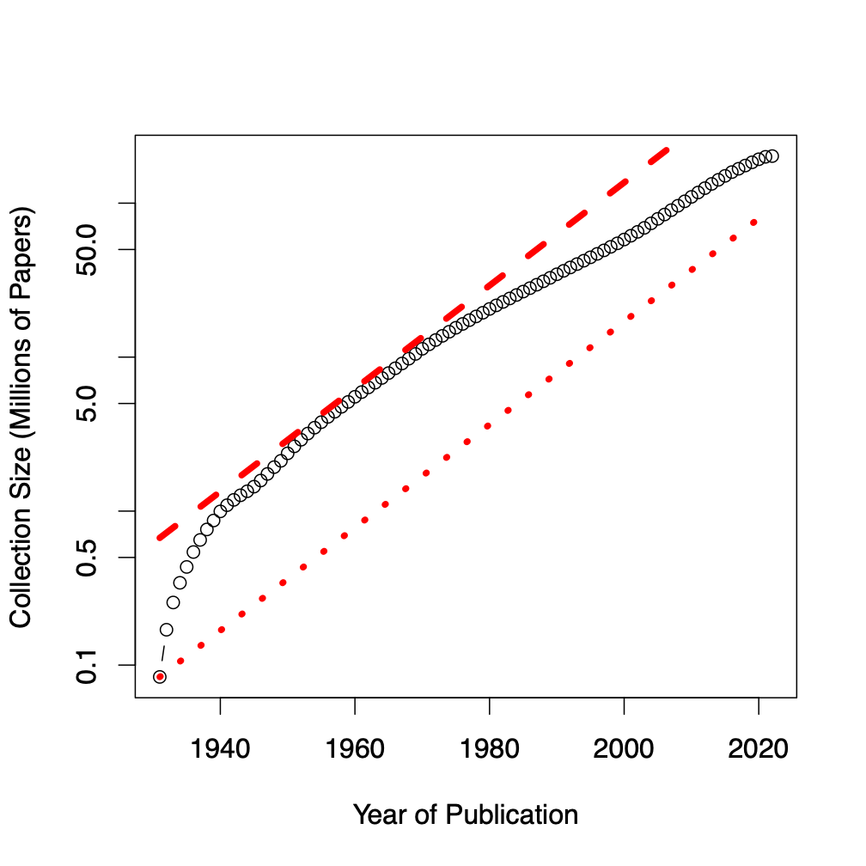
Assign 200M papers to 100 bins (by time)
Sort 200M papers by publication date
Output: Split papers into 100 bins, with 2M papers/bin
Because of exponential growth
(literature doubles every 9 years)
older bins span more time, and
newer bins span less time
Bin 99
………
Bin 0
Time
Notes:
mention equal # papers
consider replacing w/ diagram

Slide 18
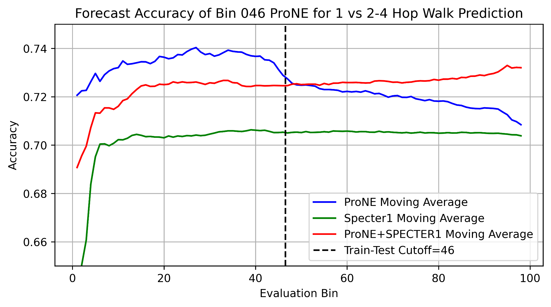
Better Together Observations
ProNE (Context) >> Specter (Text)
Ensembles are better
than either by itself
Text is most helpful
when links are not working well
i.e., long-term forecasting

Slide 19
Benchmarking Take-Aways More Realistic Benchmarks
The Real World
Idealizations (Standard Benchmarks)
Large (Metcalfe’s Law)
Growing
Dirty
Missing Values
Bad/misleading Values
Small
Static
Clean

Slide 20
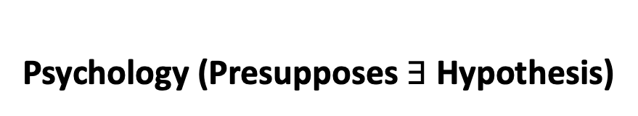
Two Perspectives on Datasets
Machine Learning
Psychology (Presupposes $∃$Hypothesis)
Splits: train/val/test
Treat rows as iid
Identical and independently distributed
Idealistic, but maybe unrealistic
Changes over time, Context, etc.
More papers on models
than Datasets
Relatively little interest in
Is the Dataset Realistic?
Motivation? (Does anyone care? If so, who?)
What is the dataset testing?
Sampling/balance? From which population?
Can it be gamed? Leakage?
Validity
Content validity
Construct validity
Criterion validity
Face validity
Discriminant validity
Reliability
Inter-rater reliability
Test-retest reliability
Internal reliability/Inter-item consistency
Split half reliability
Lexicography

Slide 21
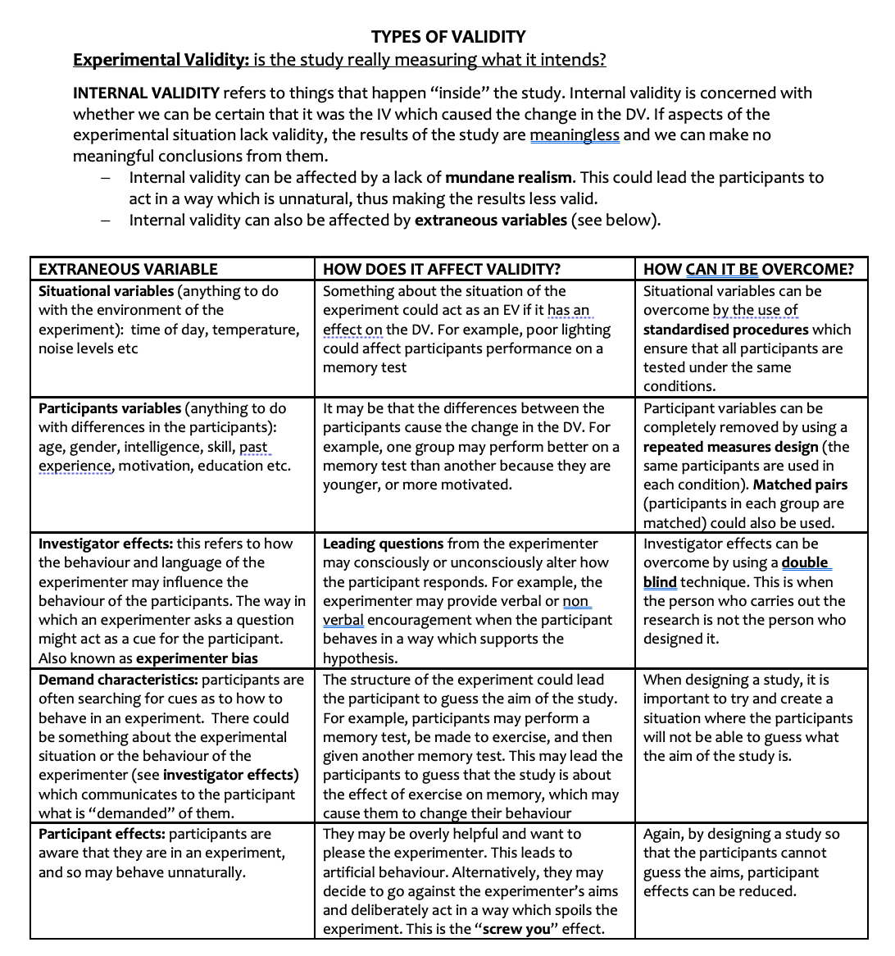
Discussion of Validity Assumes: Intention

Slide 22
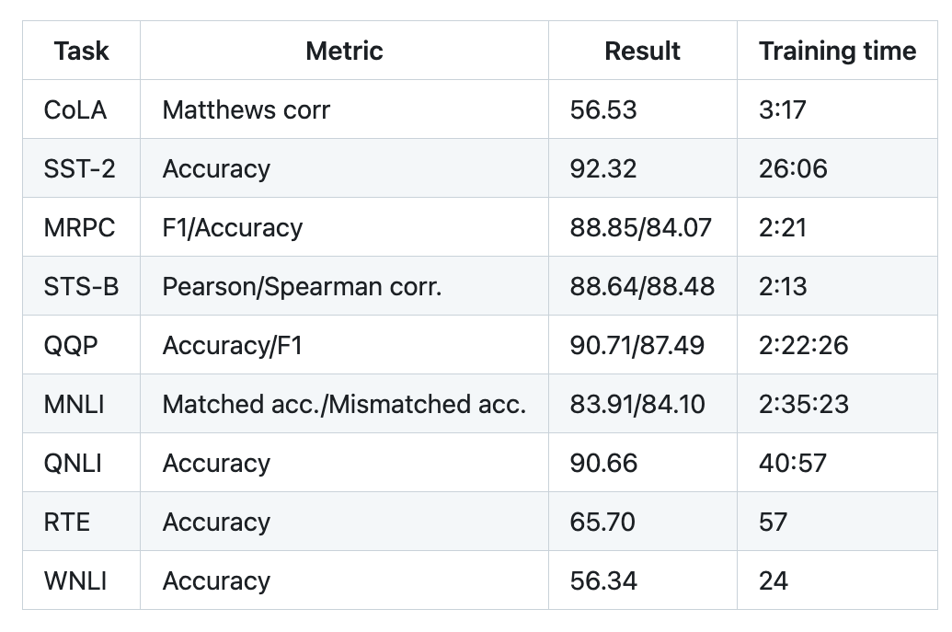
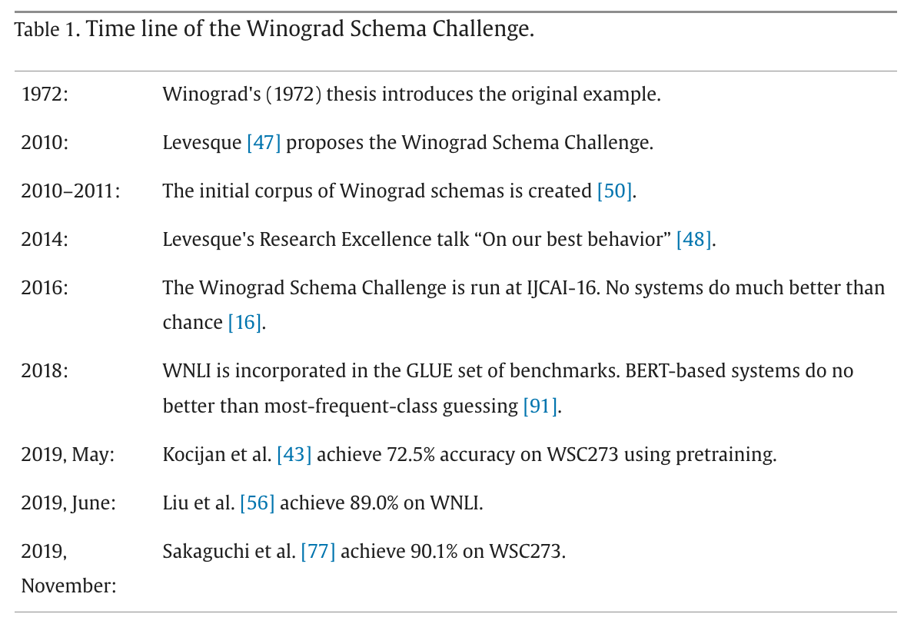
Winograd Schema (GLUE WNLI)
The trophy doesn't fit in the brown suitcase
because it is too large.
What is too large?
A. The trophy
B. The suitcase
Not much better than chance
from: https://doi.org/10.1016/j.artint.2023.103971

Slide 23
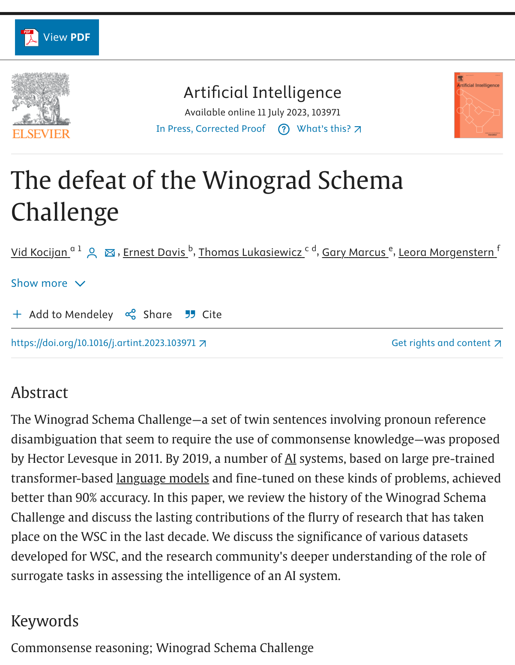
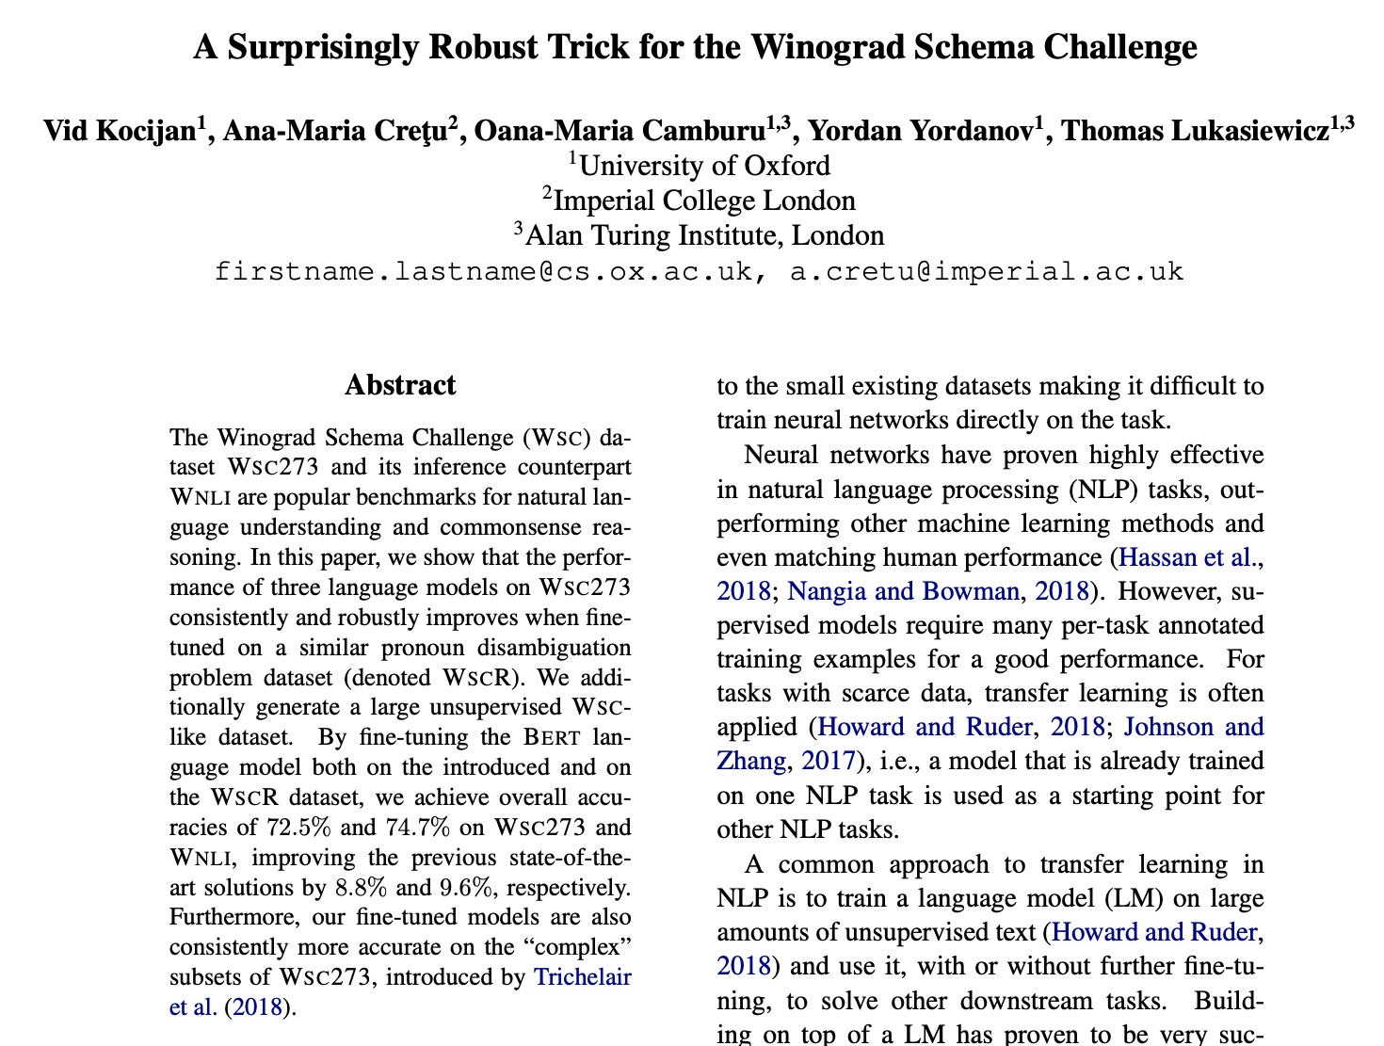
Winograd Schema (GLUE WNLI)

Slide 24
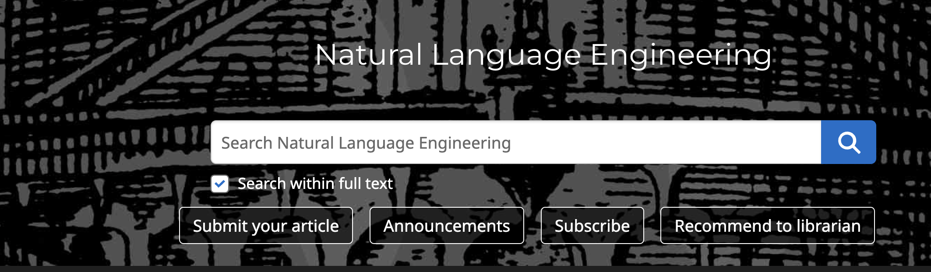
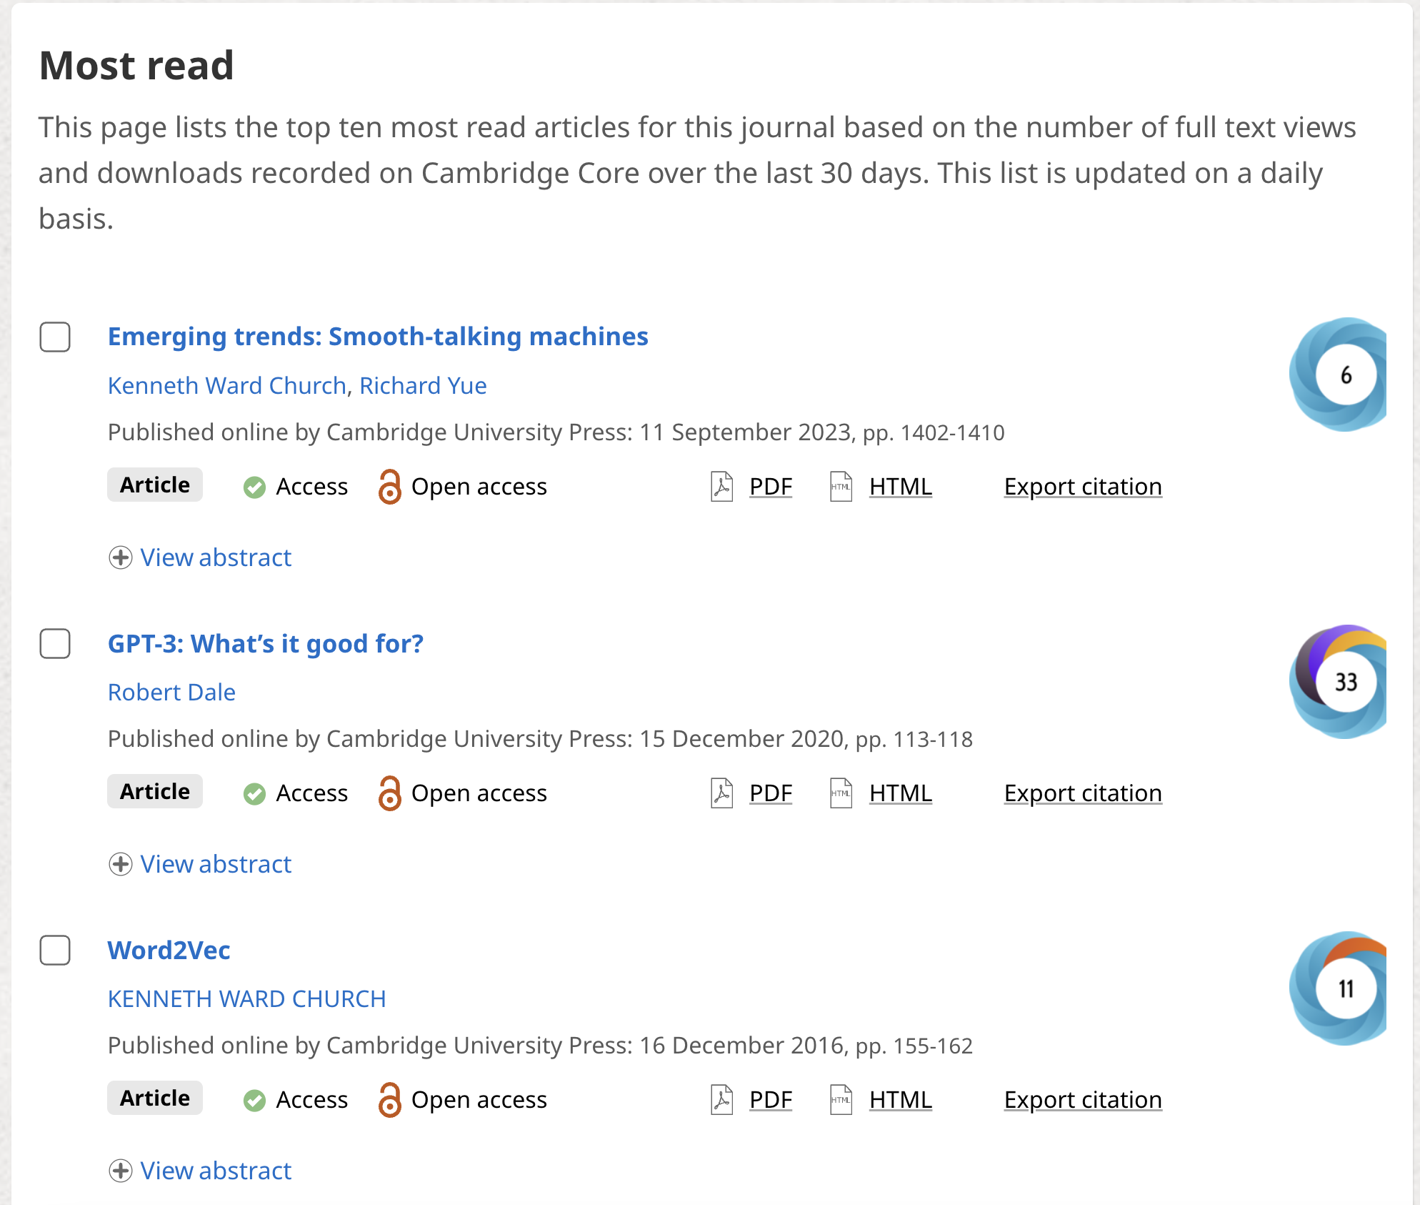
Shameless Plug: Smooth-Talking Machines

Slide 25

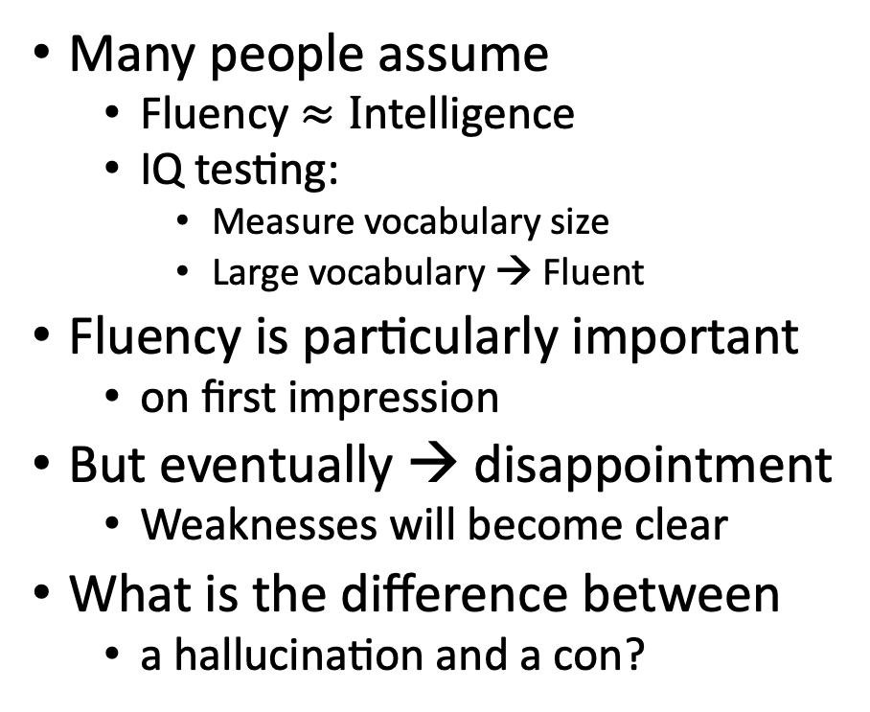

Challenge: Fluency $≠$ Trustworthiness
A number of articles on ChatGPT
lead with amazing successes
that seem too good to be true,
and end with back-peddling
ChatGPT has
amazing strengths (fluency)
as well as
amazing weaknesses (trustworthiness)
Many people assume
Fluency $≈I$ntelligence
IQ testing:
Measure vocabulary size
Large vocabulary → Fluent
Fluency is particularly important
on first impression
But eventually → disappointment
Weaknesses will become clear
What is the difference between
a hallucination and a con?

Slide 26
What should we do next?
Three paths forward:
Low road:
Give up (hallucinations)
Middle road:
Fact-checking with search
High road:
Revive rationalism (“AI Complete”)
Minsky & Chomsky
Recommendations
Short-term:
Middle Road: Search
“Good apps for Crummy MT”
Find apps for what we have
given strengths and weaknesses
Long-term:
High road may be necessary
But it is very ambitious
Inclusiveness:
Interdisciplinary Collaboration
Growth opportunities
(Low Resource Languages)

Slide 27

Hypothesis: NLP History → Strengths & Weaknesses
Deep Nets are
more fluent
than trustworthy
Pendulum Swung Too Far (2011)
Empiricism (1950s)
Rationalism (1970s)
Empiricism (1990s)
Deep Nets (2010s)
Truth
Fluency
Fluency
Fluency

Slide 28
Massive Growth → Mistaken Impression that everything is new (and there is no history)
Scientific Literature doubles every 9 years (90% written since I started PhD)
What’s new
The world is taking notice (in AI)
Fluency is much improved
What’s not new
Chatbots (and much of the tech)
SOTA-Chasing
New/better shiny objects
(with same old quality?)
Does SOTA-Chasing → Progress?
Trustworthiness is still wide open

Slide 29
Personal History
Strengths (fluency) and weaknesses (trustworthiness)
may be a consequence of choices we made in 1990s
We started EMNLP in 1990s for pragmatic reasons
Field had been attempting to do too much
and was accomplishing too little
(during a funding winter)
We chose to stop working on hard problems
(trustworthiness)
in order to make relatively quick progress on fluency
by reviving empirical methods from the 1950s
(Shannon, Skinner, Firth)
Deep Nets are
more fluent
than trustworthy
Pendulum Swung Too Far (2011)
Empiricism (1950s)
Rationalism (1970s)
Empiricism (1990s)
Deep Nets (2010s)
Fluency
Fluency
Fluency
Truth

Slide 30
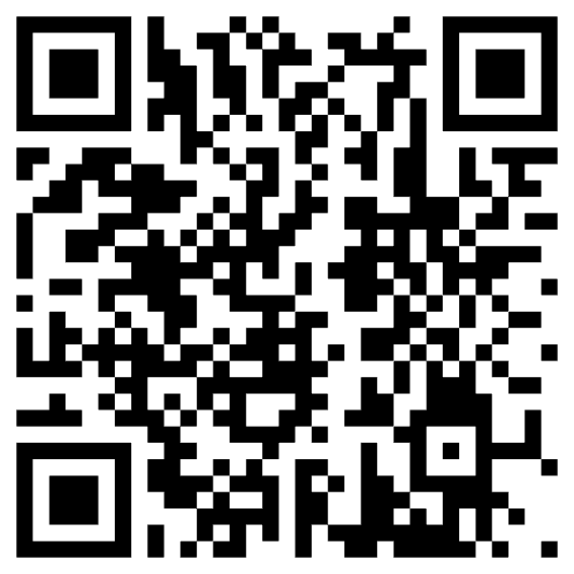
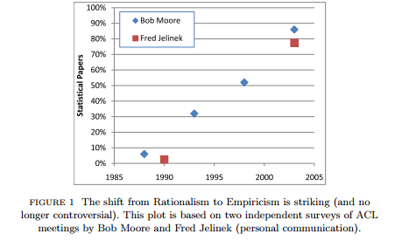
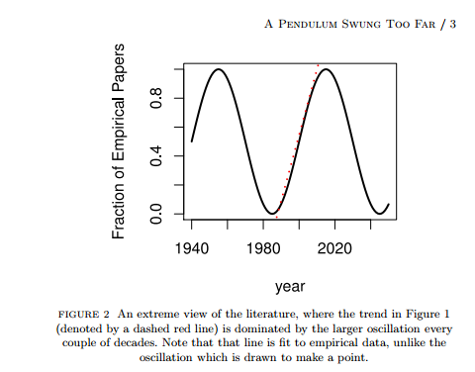
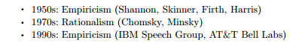
Pendulum Swung Too Far ChatGPT’s strengths (fluency) and weaknesses (trustworthiness) may be a consequence of choices we made in 1990s
Mechanism
We started EMNLP

Slide 31
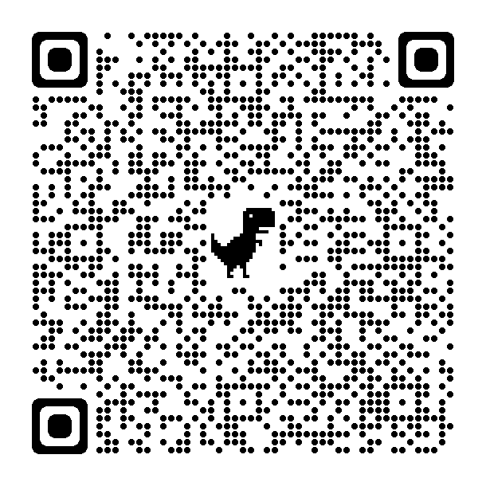
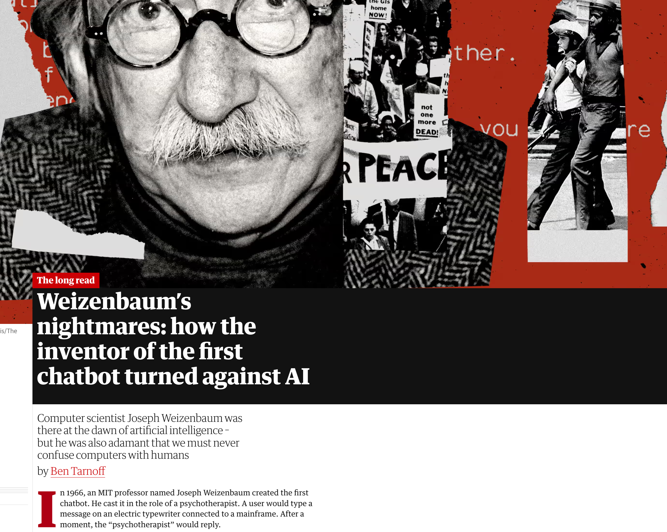
History does not repeat itself (but it rhymes)
Recent article in Guardian
Compared ChatGPT and Weizenbaum's ELIZA
https://www.theguardian.com/technology/2023/jul/25/joseph-weizenbaum-inventor-eliza-chatbot-turned-against-artificial-intelligence-ai
As a TA for Weizenbaum (1978),
I know just how horrified he was
by how seriously people took ELIZA
Responsible AI
His views were not popular at MIT
at the time

Slide 32
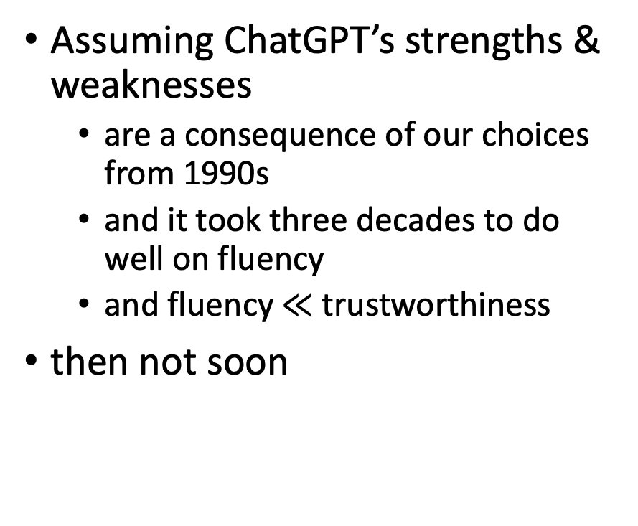
How Hard are Hallucinations? Yogi Berra
Possible answers:
Soon: “See next release”
Eventually, but not soon:
“Next Year in Jerusalem”
History of Machine Translation (MT)
When will MT be practical?
Prediction from 1950s: 5 years
Never
Assuming ChatGPT’s strengths & weaknesses
are a consequence of our choices from 1990s
and it took three decades to do well on fluency
and fluency $≪$ trustworthiness
then not soon

Slide 33
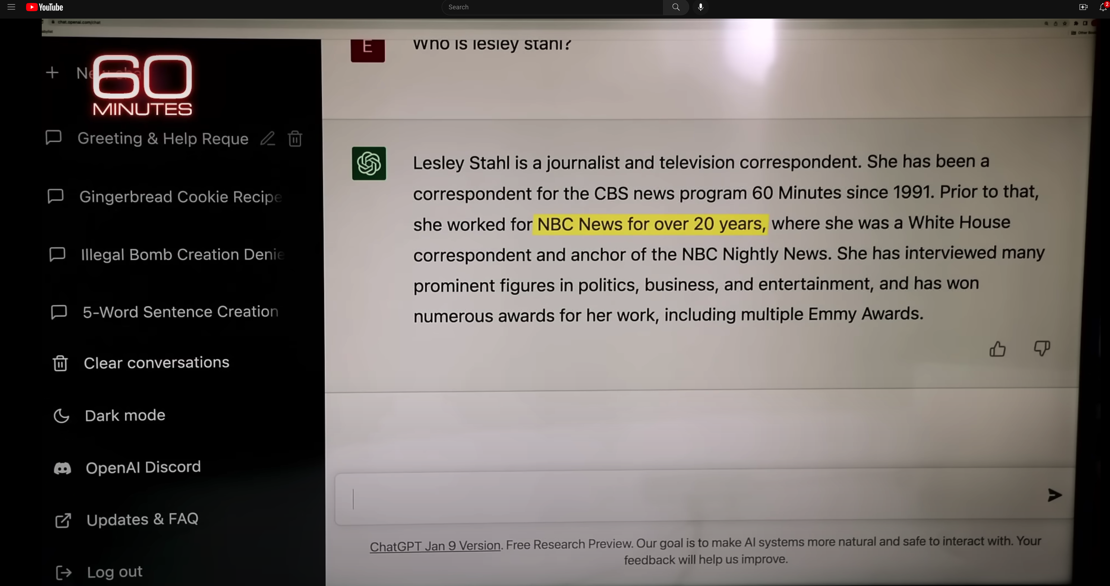
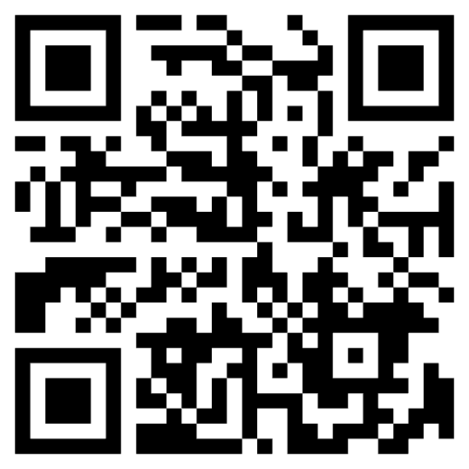
ChatGPT Hallucinates on CBS ``60 Minutes’’ https://www.youtube.com/watch?v=1wzPr4cUoMQ&t=463s
Prompt
Hallucination
https://github.com/kwchurch/ACL2022_deepnets_tutorial
33

Slide 34
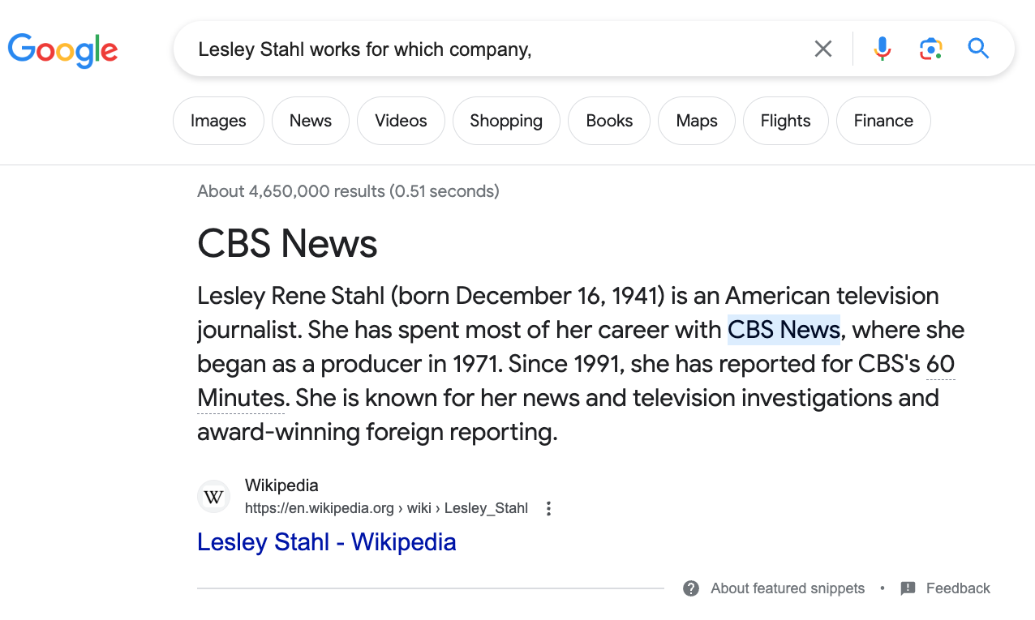
Constructive Suggestions for Hallucinations
Query: Lesley Stahl works for which company
Low Road:
Give up
Middle Road
Fact-checking with search
High Road
Revive Rationalism
CBS

Slide 35
Challenges for Fact-Checking
Which claims need to be checked?
How do we create queries?
When we get search results, then what?

Slide 36
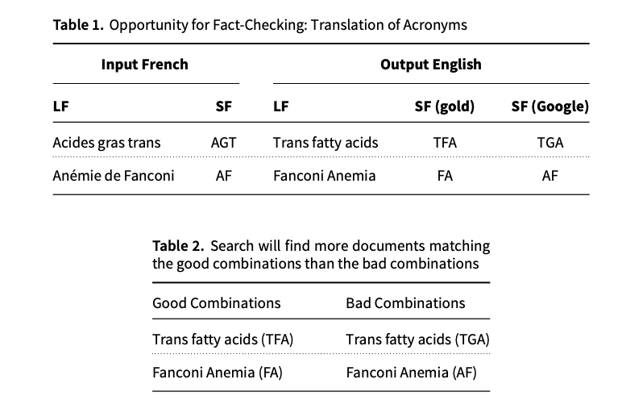
Acronyms: A Simple Case for Fact-Checking
Acronyms are easier
Google Translate is better on long forms (LFs) than short forms (SFs)
Use Google to translate LFs to target language (English)
Generate candidate SFs in target
Use search to verify candidates
Co-author (Richard Yue)
used to be a professional translator
Metrics matter:
Terminology:
important to translators
(But less so for BLEU)
De nombreux facteurs de risque participent au développement de cette pathologie, parmi lesquels les acides gras trans (AGT).
... une diminution d’expression de 12 gènes mutés dans l’anémie de Fanconi (AF)

Slide 37
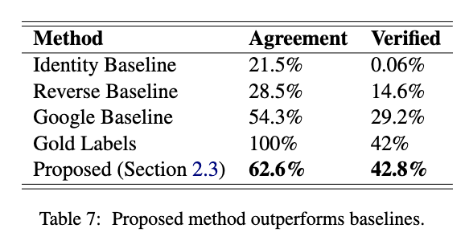
Fact-Checking Take-Aways
Short-term patch for hallucinations
Acronyms:
Easy special case of hallucinations
Don’t re-invent the wheel
Re-use existing tools: Search
Standard Loss/Metrics
Insufficient Penalty for Fatal Errors
Terminology
Responsible AI
Agreement:
hyp = gold
Verification:
Search finds 2+ examples in publications

Slide 38
Simple Example: Arithmetic (Chomsky: Capturing Relevant Generalizations)
Hypothetical
Is this progress?
Suppose ChatGPT
can add two small numbers
But for large numbers,
it makes up answers
After each release,
“small” gets “bigger”
Empiricism
According to SOTA-Chasing,
Yes
Rationalism
According to Minsky & Chomsky,
No
ChatGPT is not mastering concepts
“Stochastic Parrots”

Slide 39
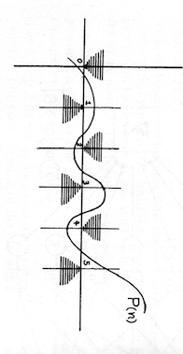

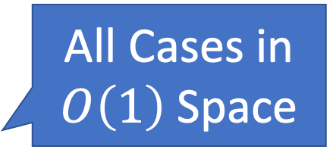
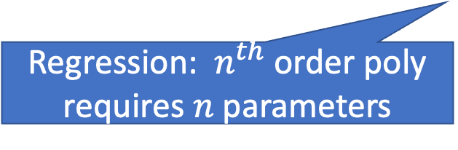
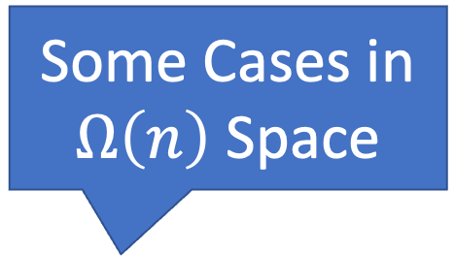
Perceptron: “Can’t Compute Parity” (Capturing Relevant Generalizations)
All Cases in
$O\left(1\right)$ Space
0
0
1
Some Cases in
$Ω\left(n\right)$ Space
Even
Odd
1
Minsky rejects deep nets (1969)
Regression: $n^{th}$ order poly requires $n$ parameters

Slide 40
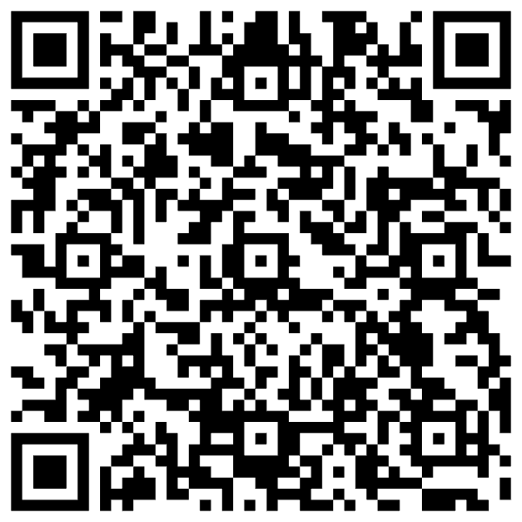
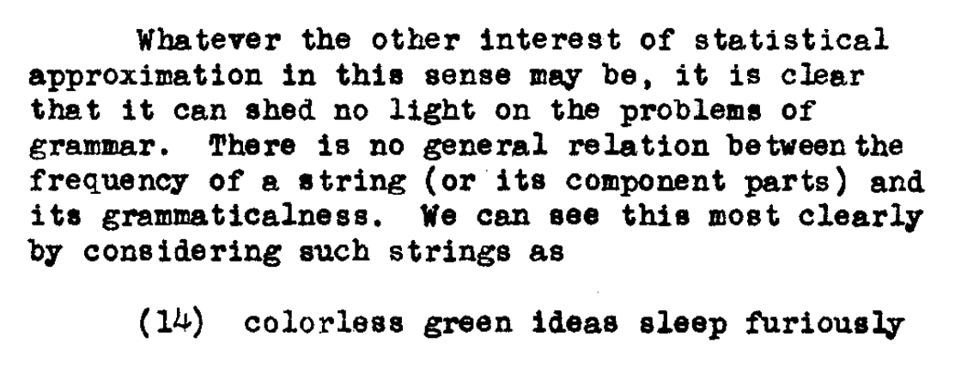
N. Chomsky, "Three models for the description of language," in IRE Transactions on Information Theory, vol. 2, no. 3, pp. 113-124, September 1956, doi: 10.1109/TIT.1956.1056813
Minsky rejects deep nets (1969)
Introduced Chomsky Hierarchy:
Finite State → Turing Machines

Slide 41
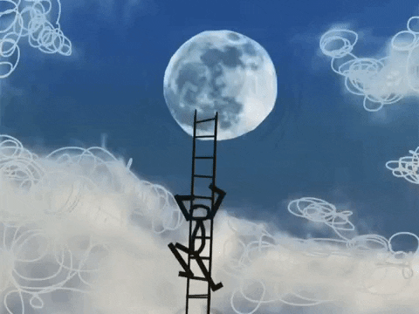
Capturing Generalizations Argument
Pros
Cons
Long-Term Focus
Can’t get to moon by
Incremental short-term local optimization
Dismisses Short-term Progress
Sometimes it is useful
to solve some simple special cases
(addition of small numbers)
Not constructive:
“MIT School of Negativity”

Slide 42
Personal History
ChatGPT’s strengths (fluency) and weaknesses (trustworthiness)
may be a consequence of choices we made in 1990s
We started EMNLP in 1990s for pragmatic reasons
Field had been attempting to do too much
and was accomplishing too little
(during a funding winter)
We chose to stop working on hard problems (trustworthiness)
in order to make relatively quick progress on fluency
by reviving empirical methods from the 1950s (Shannon, Skinner, Firth)

Slide 43
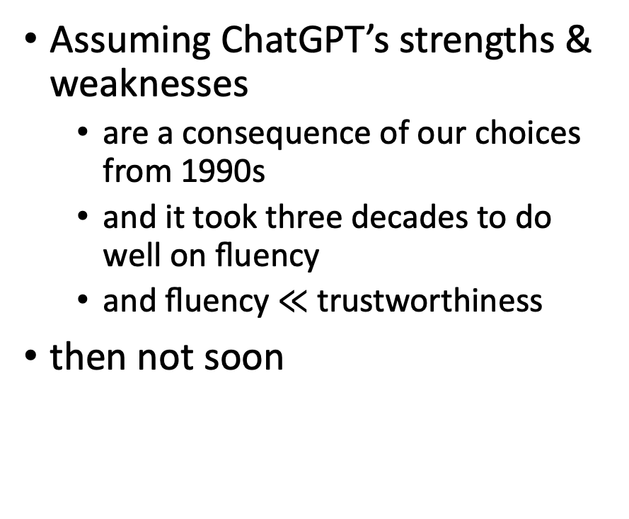
How Hard are Hallucinations?
Possible answers:
Soon: “See next release”
Eventually, but not soon:
“Next Year in Jerusalem”
History of Machine Translation
Never
Assuming ChatGPT’s strengths & weaknesses
are a consequence of our choices from 1990s
and it took three decades to do well on fluency
and fluency $≪$ trustworthiness
then not soon

Slide 44
Ugly: Outline
Benchmarking (Ken)
Labeling (Omar)
Bias, toxicity, misinformation, plagiarism (Ken)
1 slide on hard problems for researchers/practitioners

Slide 45
Ugly - Labeling

Slide 46
The bad news first
Labeling is hard
Facebook
Points-Of-Interests (Foursquare, etc.)
Labeling is going to get more difficult
Enterprise
Personalization
Healthcare
New data sets
Some context
We assume supervised or semi-supervised learning
Large scale
Continuous

Slide 47
There is hope
Human Computation
Artificial Intelligence
Computer Science
Human-Computer Interaction
Economics
Behavioral sciences
Lots of research and new ideas
This section
Programming perspective, quality framework, data pipelines, future trends
https://www.humancomputation.com/

Slide 48

What is a label?
Spam email?
Label: yes, no

Slide 49
Why we need labels?
Information retrieval
Natural language processing
Machine learning
Artificial intelligence

Slide 50
Why we care?
Provenance
Reproducibility & debugging
Explainability & interpretability
How a training set was created
Bias and fairness
Data management
ML/AI models live & die by the quality of input data
Metadata about labels
Maintenance
Lora Aroyo et al. "Data excellence for AI: why should you care?" Interactions 29(2): 66-69 (2022)

Slide 51
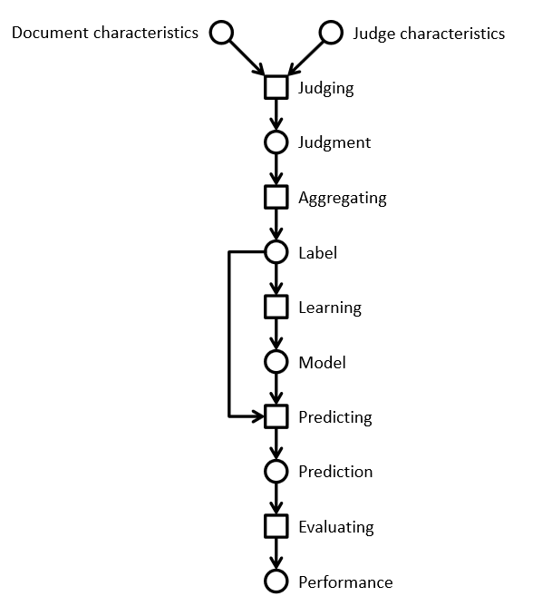
Lifecycle of a label
Information retrieval example
Using a crowd to label a data set
Using ML to process the complete data set

Slide 52
Relevance labels
Indicate whether a search result is valuable to a searcher
Key in evaluation and optimization IR systems
Editors or experts
TREC-style
Crowdsourcing
LLMs

Slide 53
Careful with that axe data, Eugene
In the era of big data and machine learning
labels -> features -> predictive model -> optimization
Labeling perceived as boring
Tendency to rush labeling
Quality is key
Garbage in, garbage out
Own the entire stack
Labeling, modeling, infrastructure, deployment

Slide 54
The state of the field
Human-labeled data is more important than ever
Requirements
Throughput -> ASAP; I need the labels for yesterday
Cost -> cheap; if possible free
Quality -> top
Performed as a one-off by 3rd party (crowd or editors)
Human Intelligence Task (HIT)
Micro-tasks
Needs development work to get good results
Very limited functionality in current platforms
Mechanical Turk, SageMaker (Amazon)
Figure Eight (Appen)
Toloka (Yandex)
Start-ups
LLMs

Slide 55
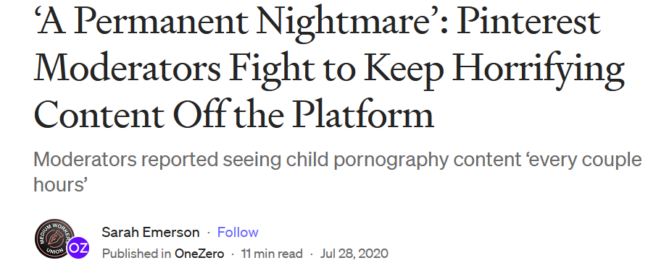
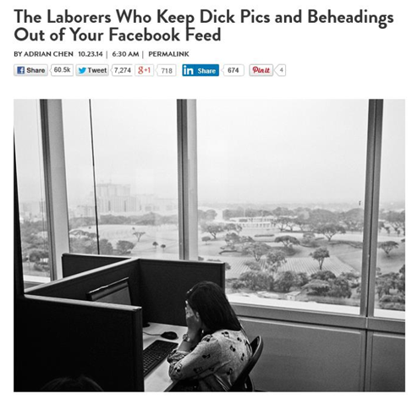

The need for humans
Many examples where humans are involved
Adult content and moderation
Baby sitting algorithms
https://onezero.medium.com/a-permanent-nightmare-pinterest-moderators-fight-to-keep-horrifying-content-off-the-platform-4d8e7ec822fe
https://www.wired.com/2014/10/content-moderation/
https://www.thebureauinvestigates.com/stories/2022-10-20/behind-tiktoks-boom-a-legion-of-traumatised-10-a-day-content-moderators

Slide 56
Problems
Monolithic HITs
The structure of a HIT mirrors the structure of the task the developer is working on
Similar to Conway’s law in software engineering
Task complexity
Lengthy instructions
RTFM doesn’t work
We don’t think of HC/crowdsourcing as programming
How to improve
Use established programming practices
Careful, we are dealing with humans and not machines

Slide 57
A spectrum of labeling tasks
Nature of task | Aggregation approach | Evaluation technique
Objective question has a correct answer (objective) | Reliable judge assigns appropriate label for an item | Evaluate workers by comparing individual results with gold set
Judgment question has a best answer (partially objective) | Inter-rater agreement determines label for an item | Evaluate workers by comparing individual results with consensus
Subjective question has consistent answer (subjective) | Repeatable polling determines probability of a label for an item | Evaluate workers by computing the consistency of results between groups

Slide 58
Prepare the environment
Homework before you label
Assess the lay of the land
Identify your use cases
Understand your product’s data
Design your HITs
Determine your guidelines
Communicate your task
Maintain high quality
Ongoing vs. one-offs HITs
Labels for the machine != labels for humans

Slide 59
HIT design principles
Self-contained, short, and simple
Document presentation
Text alignment & legibility; reading level; multi-cultural and multilingual
Cognitive biases
Implications on the final output: anchor effect, mere exposure, picture superiority
Task complexity
High cognitive load; low usability, specific expertise

Slide 60
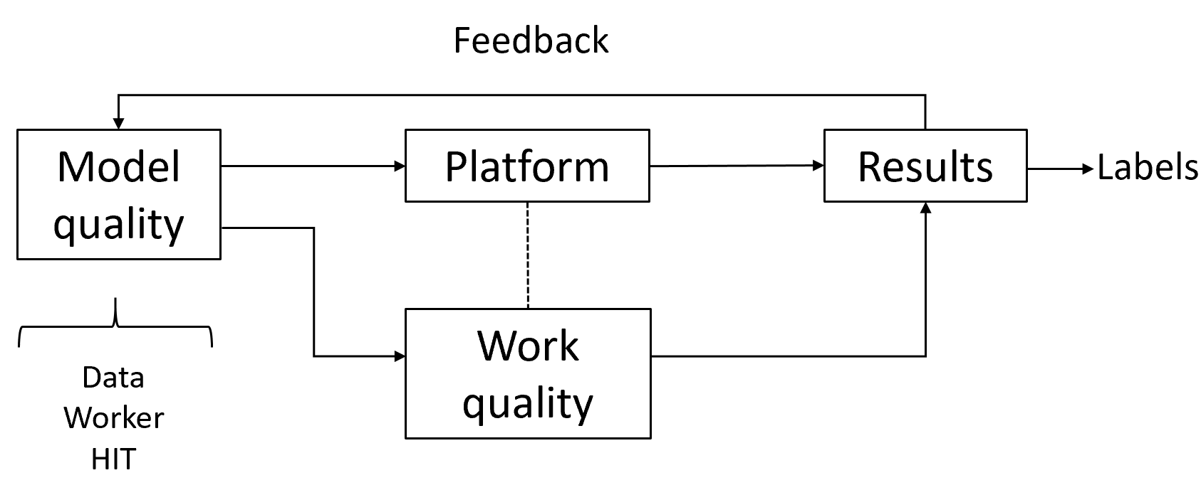
Quality control in general
Extremely important part of the task
Approach as “overall” quality; not just for workers
Bi-directional channel
You may think the worker is doing a bad job.
The same worker may think you are a lousy requester.
Quality framework
Module quality
Work quality
Measuring agreement

Slide 61
Algorithms used in practice
Voting
Majority vote, Borda, tiers
Strong baseline
Honey pots and programmatic gold
Expectation-Maximization
Get another label
Adaptivity
Quality-cost tradeoff
How many workers?
When to stop?
Stopping rules
Automatic honey pots creation

Slide 62
Behavioral features
Focus on the way workers work instead of what they produce
Task fingerprinting
High correlation with work quality
Wernicke
Information Extraction scenario
Weighted majority voting
Behavioral features outperform performance-based methods
J. Rzeszotarski and A. Kittur. “Instrumenting the Crowd: Using Implicit Behavioral Measures to Predict Task Performance”. UIST 2011.
S. Han, P. Dai, P. Paritosh, D. Huynh. “Crowdsourcing Human Annotation on Web Page Structure: Infrastructure Design and Behavior-Based Quality Control”. ACM TIST 2016

Slide 63
Active learning
Accuracy
Limited budget for annotating a small % of the unlabeled data
Speed
Model more accurate more quickly
Diversity
Uncertainty sampling
Least confidence, margin of confidence, ratio of confidence
Diversity sampling
Clustering to partition the data, real-world diversity
R. Munro. “Human-in-the-Loop Machine Learning”, Manning Publications 2021.

Slide 64
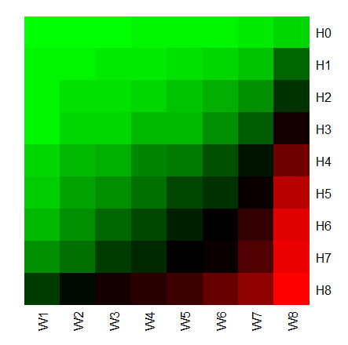
Error rates for different worker/HIT groups
Easy HITs
UHRS
2,700 HITs from 20 workloads
For difficult HITs
Good workers are doing well
Bad workers are doing poorly
For easy HITs
Good workers are doing well
Bad workers are doing well
Difficult HITs
Let error(Wi, Hj) be the average error rate of the
workers in the worker group Wi working on HITs Hj
Good workers
Bad workers
I. Abraham et al. “How Many Workers to Ask? Adaptive Exploration for Collecting High Quality Labels”. SIGIR 2016

Slide 65
Snorkel approach
Formalizing programmatic labeling
Models are commodities
pip install <what-you-want>
Training data is the interface for software 2.0
Labeling functions as black boxes that predict a label
Learn from agreements/disagreements between labeling functions

Slide 66
LLMs
Human labels are expensive
Expert > Crowd-based worker > LLM
Automatic label is not a new idea
How about using LLMs to label documents?
Potential advantages
Cost and performance
Allocate humans where are needed the most
Potential issues
Reliability
Quality control
P. Thomas et al. "Large language models can accurately predict searcher preferences" arxiv.org/abs/2309.10621
G. Faggioli et al. "Perspectives on Large Language Models for Relevance Judgment" ICTIR 2023

Slide 67
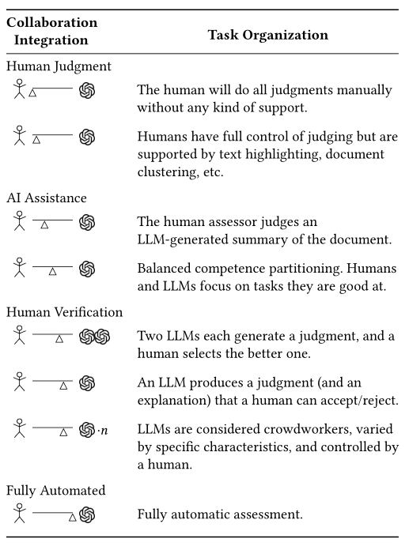
Spectrum of human-machine collaboration
LLMs judgement quality
LLMs cost
Multiple LLMs as judges
Truthfulness
Bias
Explanations/justifications

Slide 68
Prompting
In-context learning
New capabilities can be unlocked in LLMs
LLM is prompted with a few in-context demonstrations
Learns to perform a certain task
Task performance is very sensitive to prompts

Slide 69
Setup
Similar to crowdsourcing work
Take TREC judgement guidelines
HIT in Mturk
Prompt for GPT or similar LLM
Compute agreement using Cohen’s kappa
Two main approaches
Prompt “as is”
Prompt engineering

Slide 70
Prompt structure
Relevance evaluation task
Task instructions
You are a search quality rater evaluating relevance of web pages
Query-document pair to be labelled
Query {query}
Document {document}
Relevant?
Re-state the task
Output format

Slide 71
Discussion
In favor
LLMs are able to produce an explanation
This could be used to assist humans in relevance judgements
Against
LLMs are not users
IR is about relevance to an information need
No proof that evaluation by LLM has any relationship to reality

Slide 72
The main process is unchanged
Regardless if labeling is done by machines or humans
Three main components
Task design
HIT or prompt engineering
Data
Crowd
Human-based crowd or LLM-based crowd
Quality control
Debugging

Slide 73


Prompts compared to HITs

Slide 74


Preliminary results
With no prompt engineering
With prompt features
R (role), D (description), A (aspects), M (multiple judges)
Performance varies per feature
Cohen’s k (0.20 to 0.64)

Slide 75
Discussion
In favor
LLMs are able to produce an explanation
This could be used to assist humans in relevance judgements
Against
LLMs are not users
IR is about relevance to an information need
No proof that evaluation by LLM has any relationship to reality
Things to consider
Reliability over time
Cost in prompt engineering
Caveat
LLMs are systems
Query intent and answer construction

Slide 76


LLMs and human computation
For a LLM like ChatGPT, p(w_{i}|w₁,…,w_{i-1}) is defined by a transformer
LLM-based system do require editorial work
Not different from any major property on the Internet
https://time.com/6247678/openai-chatgpt-kenya-workers/
https://www.nbcnews.com/tech/innovation/openai-chatgpt-ai-jobs-contractors-talk-shadow-workforce-powers-rcna81892

Slide 77

The main process is unchanged
Regardless if labeling is done by machines or humans
Three main components
Task design
HIT or prompt engineering
Data
Crowd
Human-based crowd or LLM-based crowd
Quality control
Debugging
 | Machine computation | Human computation
Design | Throw away | Reluctant to throw away
Testing | Systematic | Ad-hoc
Debugging | Programmer’s fault | Worker’s fault
J. Attenberg, P. Ipeirotis, F. Provost. “Beat the Machine: Challenging Humans to Find a Predictive Model’s ‘Unknown Unknowns’”. ACM JDIQ 2015

Slide 78
The Easy, the Hard and the Ugly
Easy
Inference (fit)
Fine-Tuning (predict)
Hard
Pre-training
Ugly (Responsible AI)
Bias
Toxicity
Misinformation
Hallucinations
Plagiarism

Slide 79



History of Irresponsible AI Risk (5 years ago) Product gets canceled
Stupidity: To err is human…
Spelling Correction
Obama → Osama
Bots:
Kids chat with Santa
Snow → I like drugs too…

Slide 80

Are we losing ground??? Are we at fault???
2016
2022
Old risks: (work in progress)
Bias, Fairness
New risks: (bigger than us)
Genocide, Insurrection
Root causes:
ML + Social Media → Addiction
Max Engagement → Dangerous
Insanely profitable:
Companies & Countries
Long book, but no mention of our efforts to address old risks

Slide 81

Reporter wanted to talk about new risks; Accused Facebook of pivoting to old risks https://www.technologyreview.com/2021/03/11/1020600/facebook-responsible-ai-misinformation/

Slide 82






Ugly: Responsible AI
Incentives matter
Risks 1.0 (2016)
Unfair, Biased
Risks 2.0 (2022)
Addictive, dangerous, deadly
and insanely profitable
Risks 3.0 (2023)
Malware
Spyware
Challenge for Regulation
Business case $≠$ Public Interest (Health, National Security)
Tobacco companies maximize sales; ditto for fast food & junk food
Risks 2.0 (Toxicity): Good for social media companies; we ❤️ click bait
Risks 3.0 (Conflict): Good for defense industry

Slide 83


Winter is Coming
We tend to be impressed by people that speak/write well
Fluency → well-read → success → smart
Machines are better than people on many tasks (spelling),
Now that machines are more fluent than people, are they smarter?
Fear: AI Winter
there will be disappointment
when public realizes
fluency $≠$intelligence
Pendulum Swung Too Far
There have been many AI Winters
Often, after ``irrational exuberance’’
(like current excitement with nets)

Slide 84


Recommendation: Go for Singles (Not Home Runs)
Need some short-term successes for ChatBots
that take advantage of strengths
and avoid weaknesses
Suggestion
Collaborate with students on essays
You have no idea how much we’re using ChatGPT
Cheating?
ChatGPT is better for some tasks
Good: thesis statements, outlines
Bad: capture student’s voice
Worse: quotes
Learning opportunity:
How to decompose writing to subtasks
Collaboration is great,
but student is responsible for end-product
Factoring example

Slide 85
What should we do next?
Three paths forward:
Low road:
Give up (hallucinations)
Middle road:
Fact-checking with search
High road:
Revive rationalism (“AI Complete”)
Minsky & Chomsky
Recommendations
Short-term:
Middle Road: Search
“Good apps for Crummy MT”
Find apps for what we have
given strengths and weaknesses
Long-term:
High road may be necessary
But it is very ambitious
Inclusiveness:
Interdisciplinary Collaboration
Growth opportunities
(Low Resource Languages)

